Slide 1
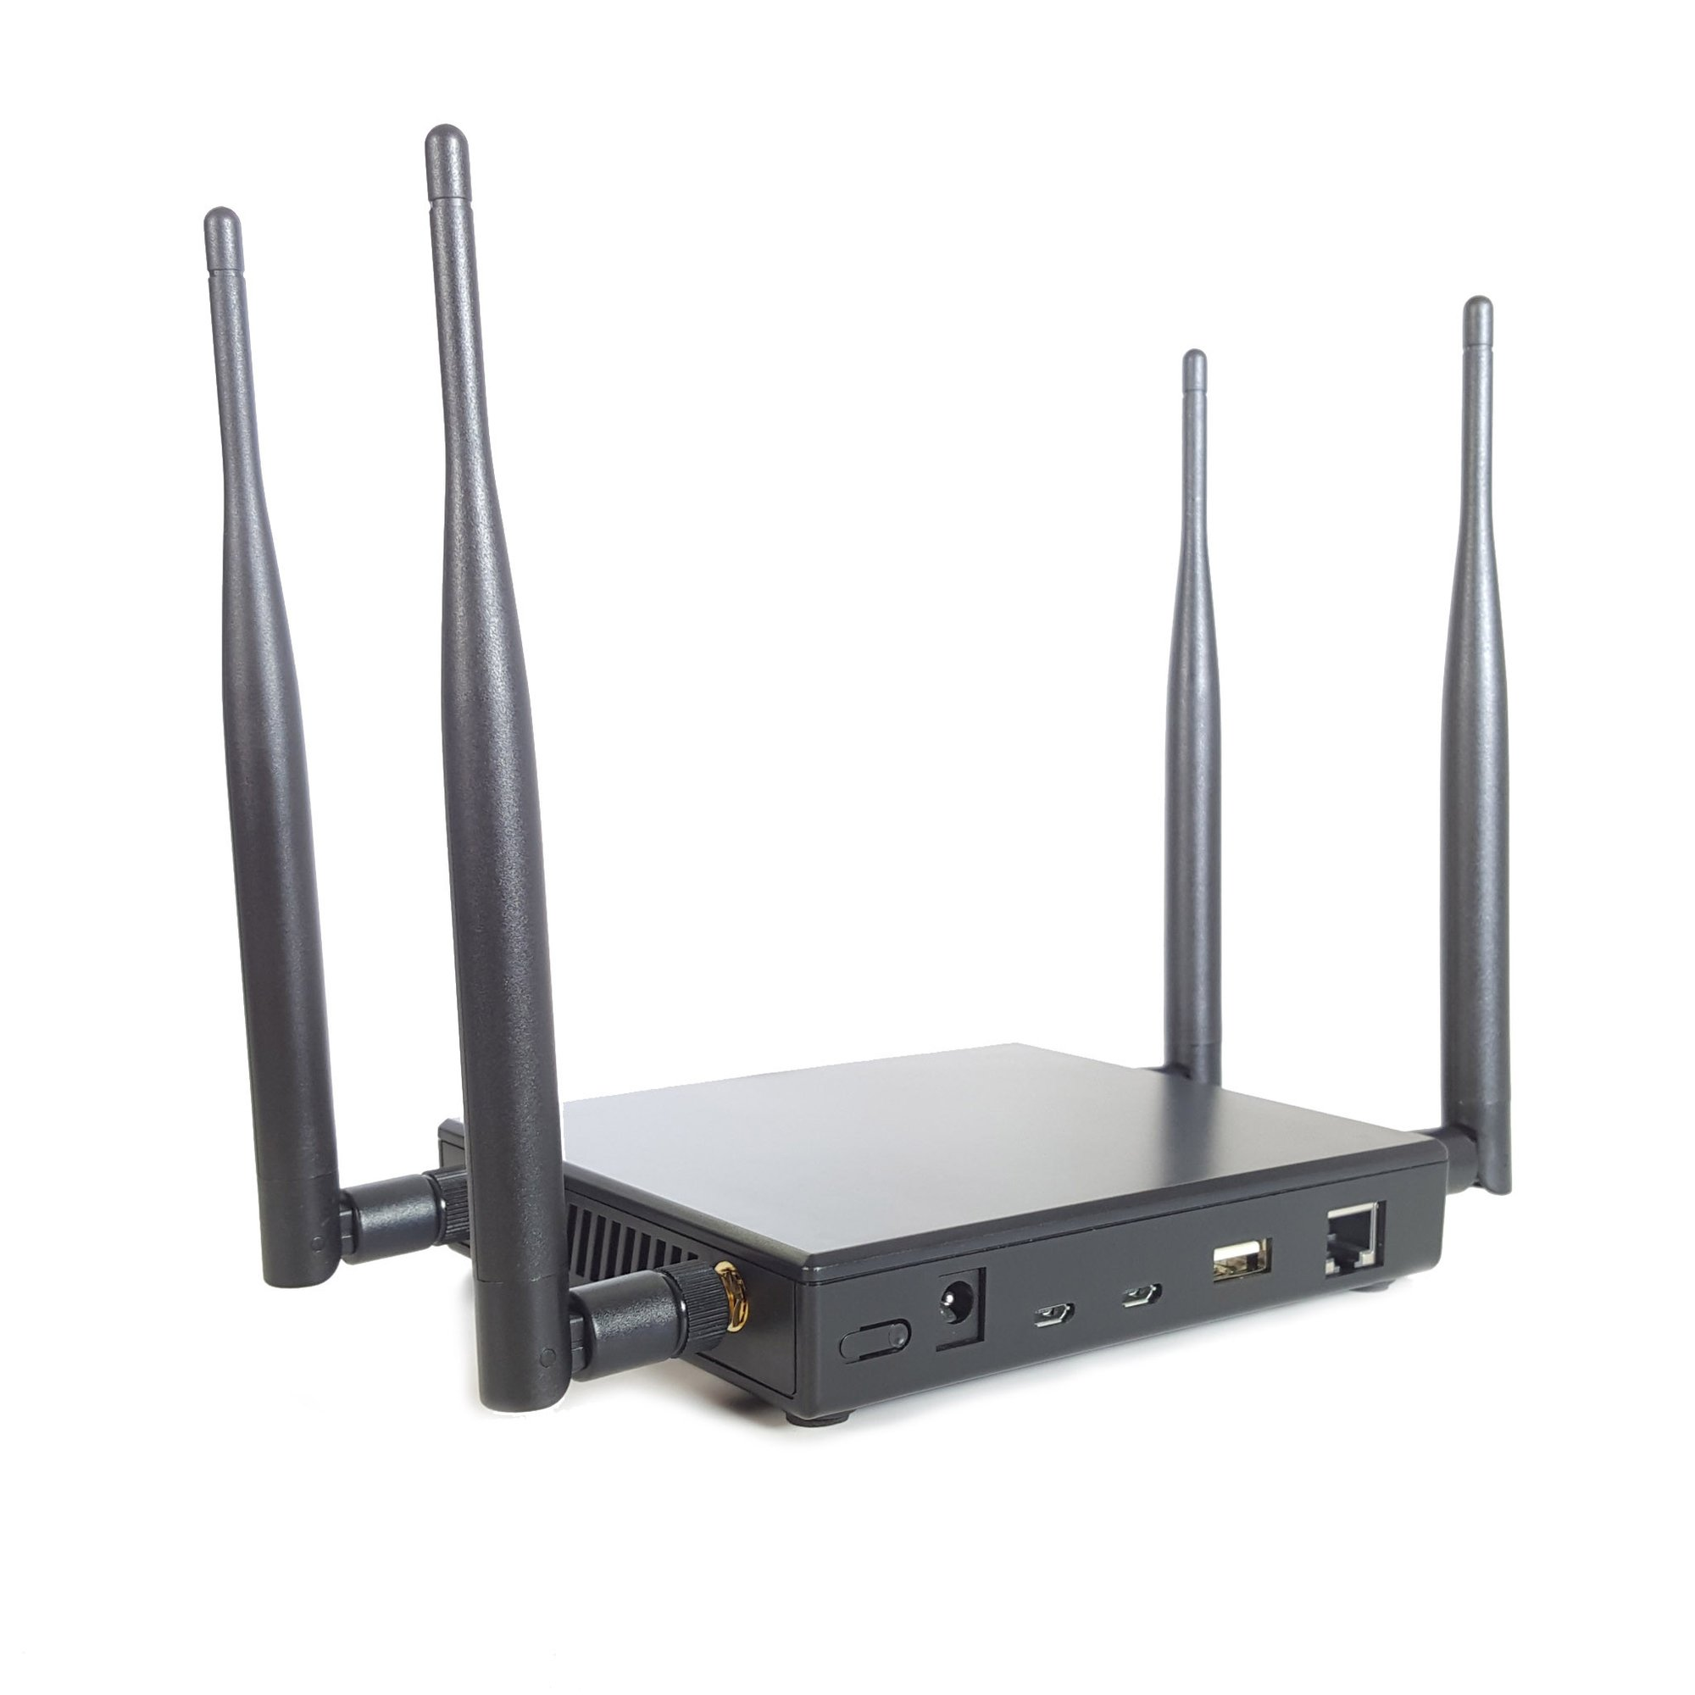
Hacking WiFi with the Pineapple Tetra

Slide 2
Agenda
Benefits
Methodology
Resources

Slide 3
Benefits (1 of 3)
GUI or Terminal Driven
Dedicated Hardware (No need to fight with Kali / Airmon-ng etc.)
Can be Battery Powered (hide it and walk away)

Slide 4
Benefits (2 of 3)
Maintain Remote Access
Operate With a Mobile Device
Targeted Access Points or Targeted Clients (easily stay in scope)

Slide 5
Benefits (3 of 3)
Connection Sharing over Ethernet
Community Developed Modules
MAC Address spoofing (Persists through Pineapple Reboots)

Slide 6
Methodology (1 of 4)
Discovery / Scanning
WPS
WEP
WPA/WPA2
WPA3
WPA-Enterprise

Slide 7
Methodology (2 of 4)
Capture Handshakes
WPA
EAP (Enterprise)
Trying to capture the 4 way handshake
1) SNonce
2) ANonce
3) AP MAC
4) Client MAC
Either all 4 packets, OR packet 1 and 2, OR packet 2 and 3

Slide 8
Methodology (3 of 4)
Attacking Access Points

Slide 9
Methodology (4 of 4)
Attacking Clients

Slide 10
Resources 1 of 2
Purchase Page - $100 for Nano or $200 for Tetra (Device We Demoed)
Support Page
Tetra Setup Basics
WiFi Pineapple Tetra - Linux Setup
WiFi Pineapple Wiki
Hacking Exposed Wireless 3rd Edition
Lynda.com - Ethical Hacking: Wireless Networks local library card for free access

Slide 11
Resources 2 of 2
Key Reinstallation Attacks - KRACK
DragonBlood White Paper
DragonBlood HomePage

